Slide 1




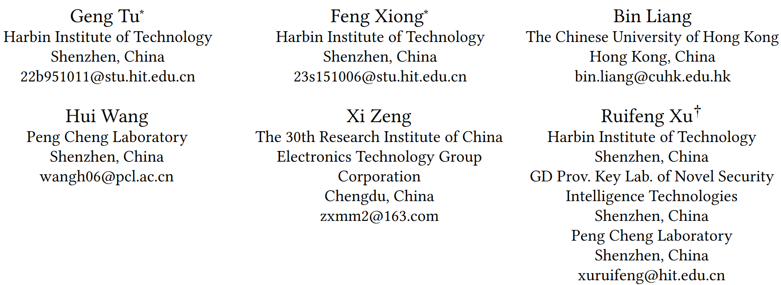





ATAI
Advanced Technique of Artificial Intelligence
ATAI
ChongqingUniversity _{AdvancedTechniqueof}
of Technology Artificial Intelligence
Chongqing University of Technology
Chongqing University ^{ATAI}
_{of Technology} Advanced Techniqueof
Artificial Intelligence
Chongqing University of Technology
Chongqing University of Technology
Multimodal Emotion Recognition Calibration in Conversations
code:none
—— MM ’24
Reported by Shu Ming Jiang
1

Slide 2
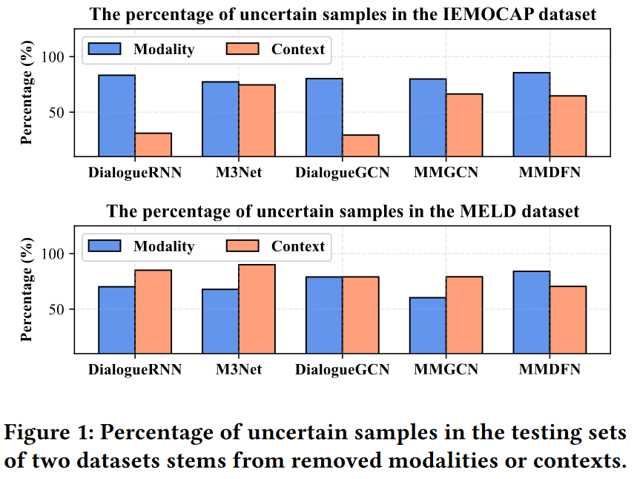
ATAI
Advanced Technique of
Artificial Intelligence
ATAI
ChongqingUniversity _{AdvancedTechniqueof}
of Technology Artificial Intelligence
Chongqing University of Technology
Motivation
Extensive empirical studies reveal that current methods suffer from unreliable predictive confidence. Specifically, in some cases, the confidence estimated by these models increases when a modality or specific contextual cues are corrupted, defining these as uncertain samples.

Slide 3
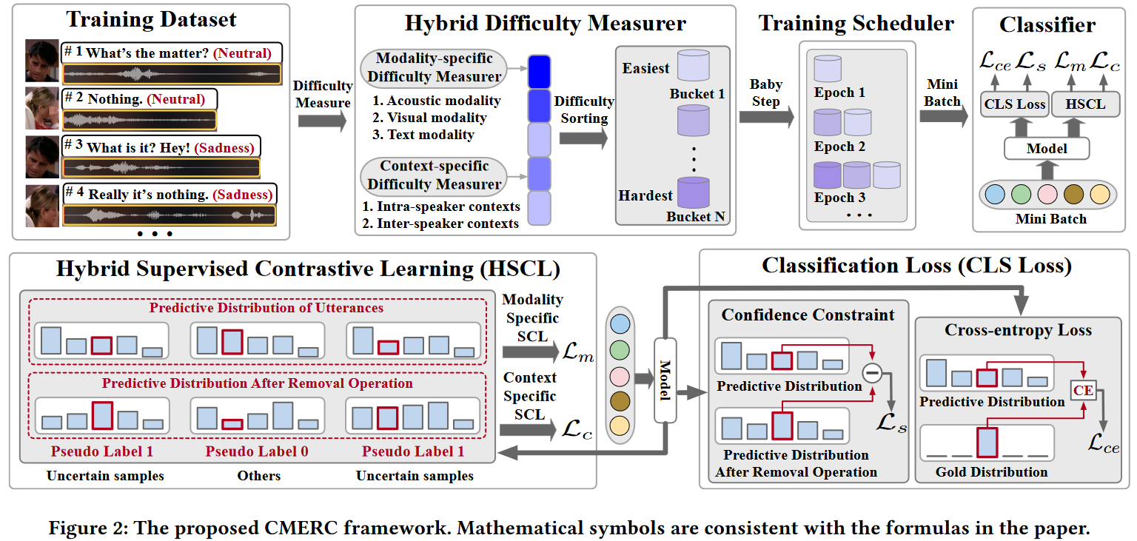
ATAI
Advanced Technique of
Artificial Intelligence
ATAI
ChongqingUniversity _{AdvancedTechniqueof}
of Technology Artificial Intelligence
Chongqing University of Technology
Overview

Slide 4
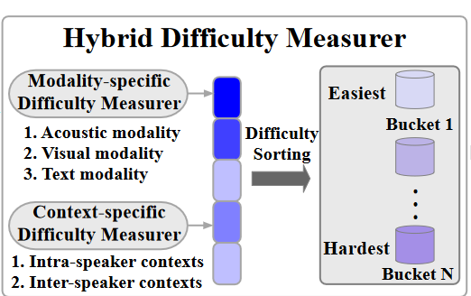
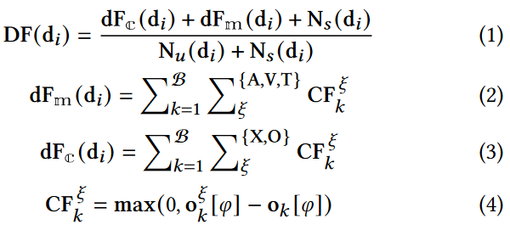
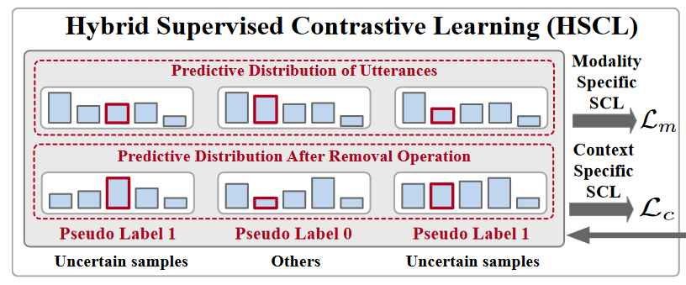
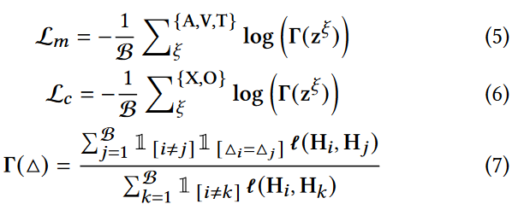
ATAI
Advanced Technique of
Artificial Intelligence
ATAI
ChongqingUniversity _{AdvancedTechniqueof}
of Technology Artificial Intelligence
Chongqing University of Technology
Method

Slide 5
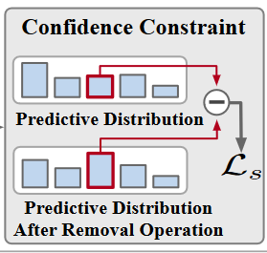

ATAI
Advanced Technique of
Artificial Intelligence
ATAI
ChongqingUniversity _{AdvancedTechniqueof}
of Technology Artificial Intelligence
Chongqing University of Technology
Method

Slide 6
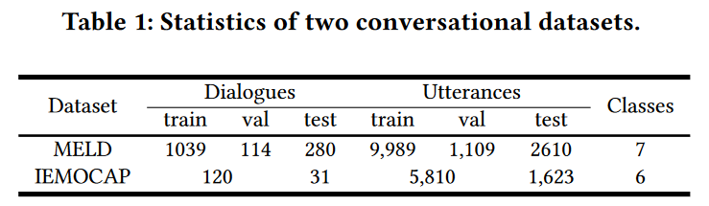
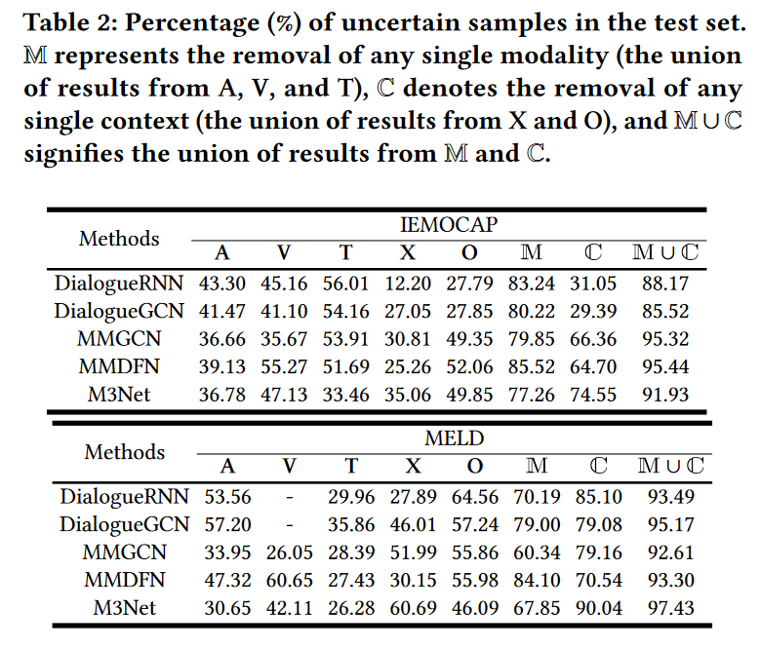
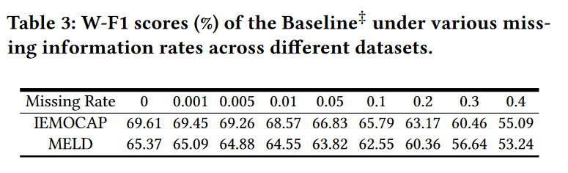
ATAI
Advanced Technique of
Artificial Intelligence
ATAI
ChongqingUniversity _{AdvancedTechniqueof}
of Technology Artificial Intelligence
Chongqing University of Technology
Experiments

Slide 7
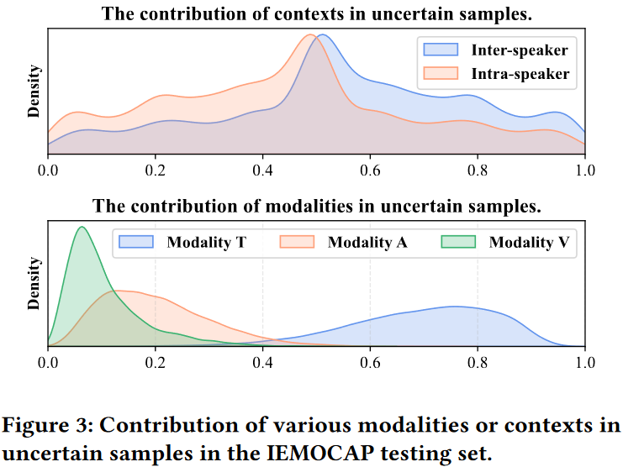
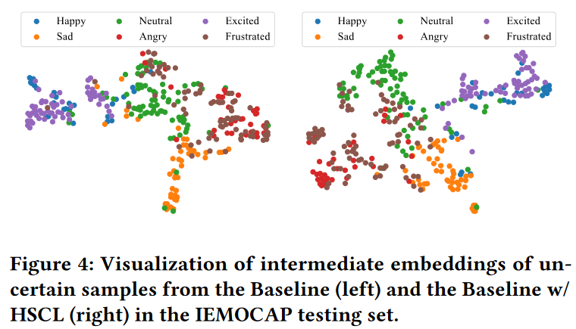
ATAI
Advanced Technique of
Artificial Intelligence
ATAI
ChongqingUniversity _{AdvancedTechniqueof}
of Technology Artificial Intelligence
Chongqing University of Technology
Experiments

Slide 8
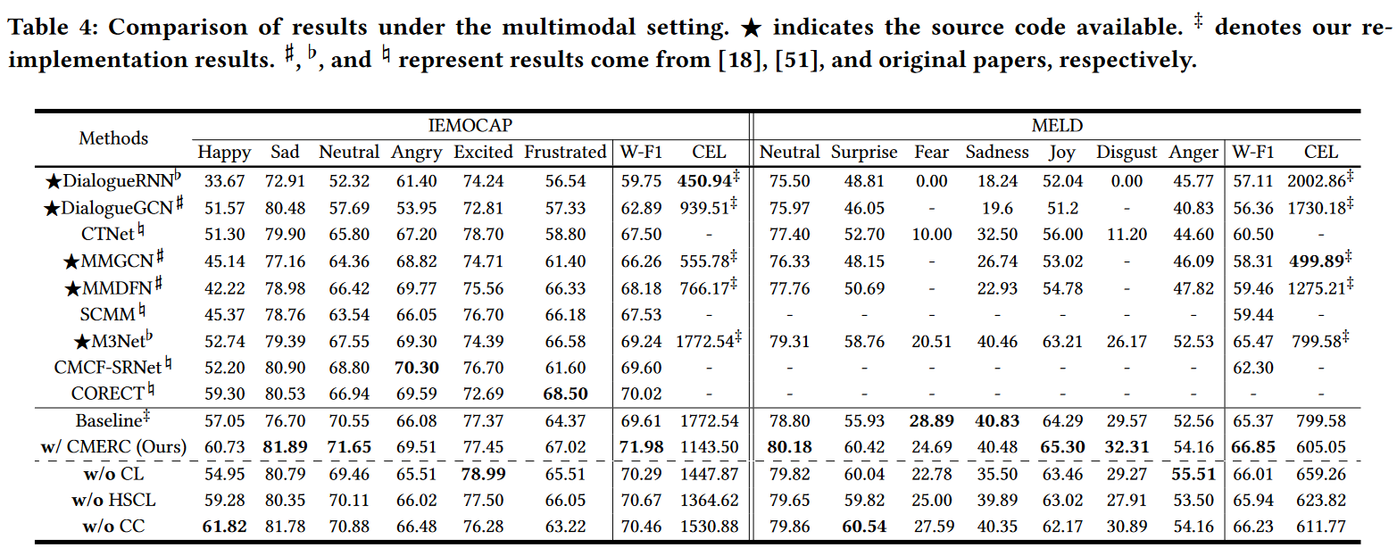
ATAI
Advanced Technique of
Artificial Intelligence
ATAI
ChongqingUniversity _{AdvancedTechniqueof}
of Technology Artificial Intelligence
Chongqing University of Technology
Experiments

Slide 9
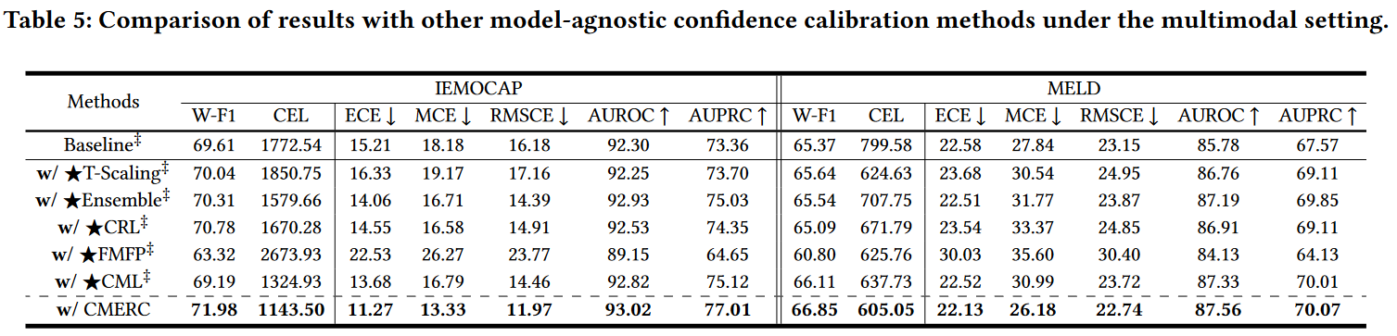
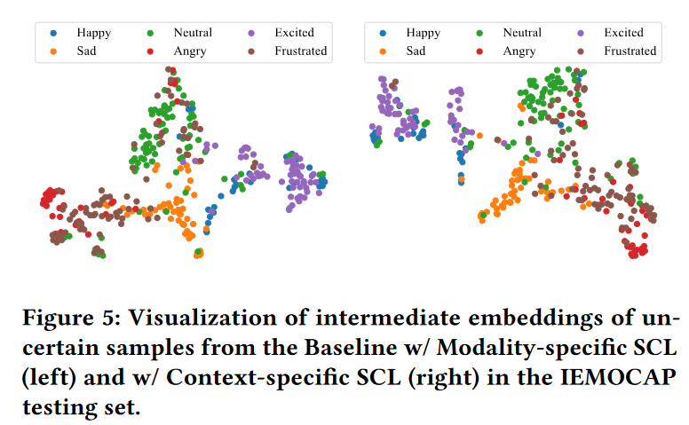
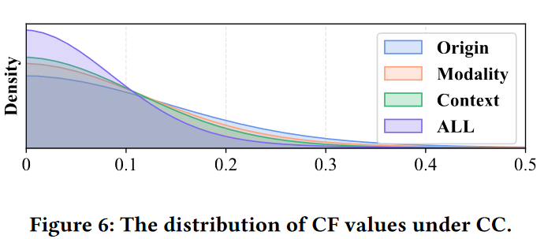
ATAI
Advanced Technique of
Artificial Intelligence
ATAI
ChongqingUniversity _{AdvancedTechniqueof}
of Technology Artificial Intelligence
Chongqing University of Technology
Experiments

Slide 10
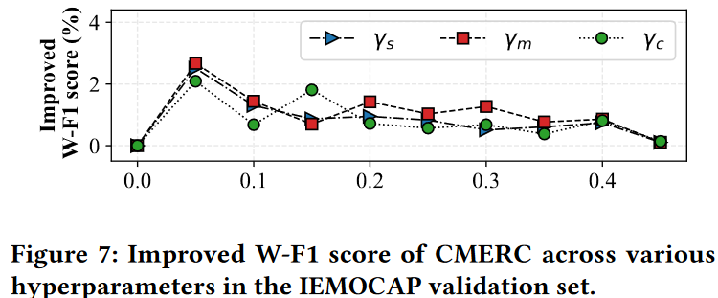
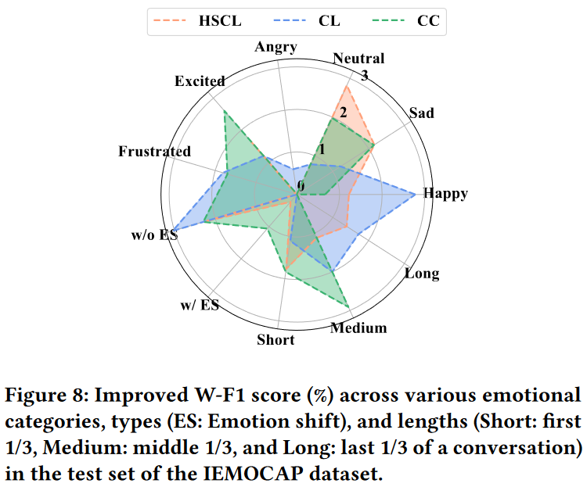
ATAI
Advanced Technique of
Artificial Intelligence
ATAI
ChongqingUniversity _{AdvancedTechniqueof}
of Technology Artificial Intelligence
Chongqing University of Technology
Experiments

Slide 11
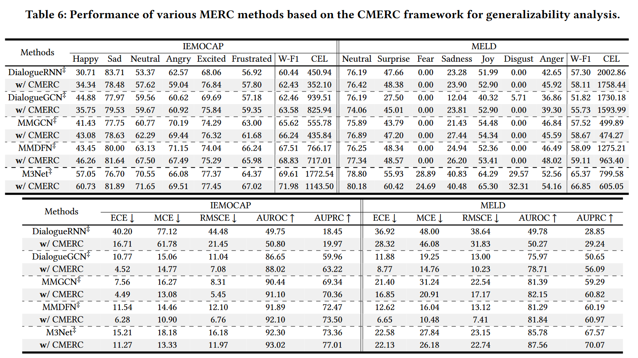
ATAI
Advanced Technique of
Artificial Intelligence
ATAI
ChongqingUniversity _{AdvancedTechniqueof}
of Technology Artificial Intelligence
Chongqing University of Technology
Experiments

Slide 12
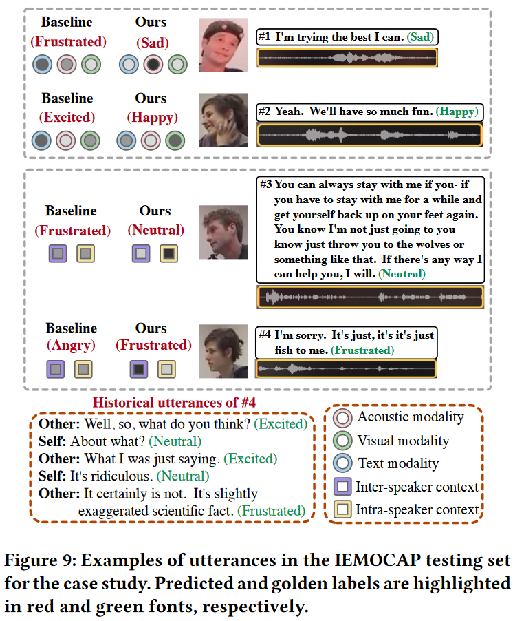
ATAI
Advanced Technique of
Artificial Intelligence
ATAI
ChongqingUniversity _{AdvancedTechniqueof}
of Technology Artificial Intelligence
Chongqing University of Technology
Experiments

Slide 13


ChongqingUniversity of Technology
ATAI
Advanced Technique of
Artificial Intelligence
ATAI
ChongqingUniversity _{AdvancedTechniqueof}
of Technology Artificial Intelligence
Chongqing University of Technology
Thanks!

Slide 14
ChongqingUniversity of Technology
ATAI
Advanced Technique of
Artificial Intelligence
ATAI
ChongqingUniversity _{AdvancedTechniqueof}
of Technology Artificial Intelligence
Chongqing University of Technology
Thanks!

